Slide 1

ASSESSMENT OF THE EFFECT OF SORTING ATTRIBUTES ON MENTAL WORKLOAD
Under the guidance of:
Dr. Vinay V Panicker
Associate Professor
Dept. of Mechanical Engineering
Presented By:
Vikas Kumar
M210545ME
Industrial Engineering and Management

Slide 2
Outline of the Presentation
Motivation for the study
Introduction
Literature review
Research gap
Project Objectives
Experimental Setup
Methodology adopted
Project timeline
References

Slide 3
MOTIVATION FOR THE STUDY
The study of mental workload (also known as cognitive workload) is one of the most important activities in the domain of psychology, ergonomics, and human factors.
The number of publication of research articles about mental workload has increased.
Mostly the mental workload is correlated with that of the human performance.
The estimation of mental workload helps not only in increasing the efficiency of worker but also in avoiding the fatigue related health issues.

Slide 4
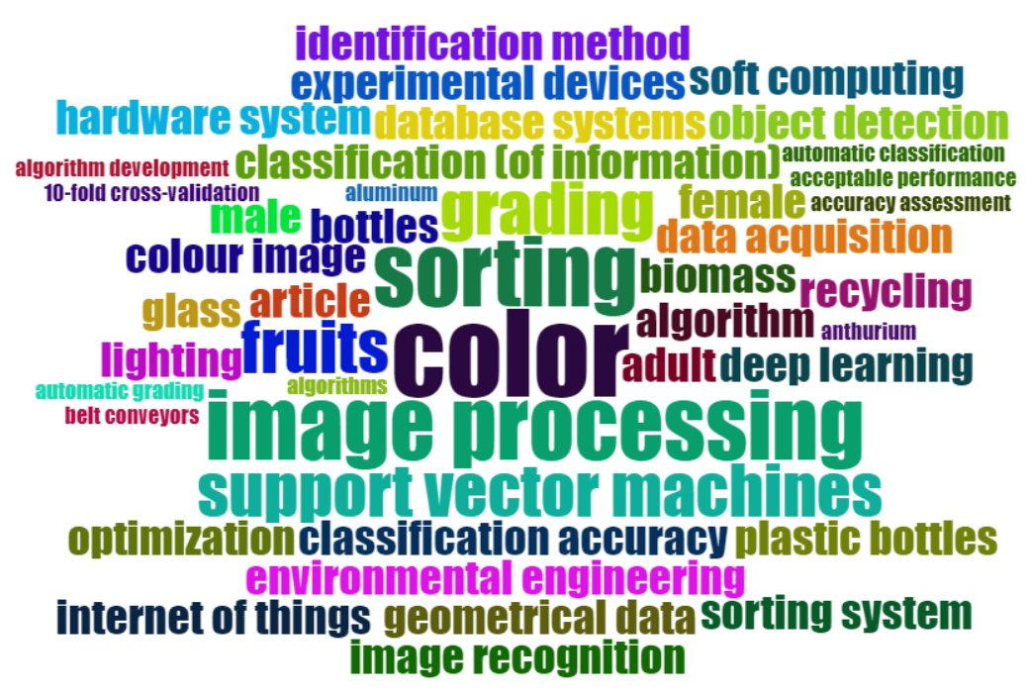
Word Cloud

Slide 5
INTRODUCTION
Manual sorting is the technique which is used in most of the micro, small and medium enterprises in India.
Some of the real-world applications of manual sorting include food industry, waste processing, e-commerce industry etc.
Manual sorting involves both physical and cognitive work.

Slide 6
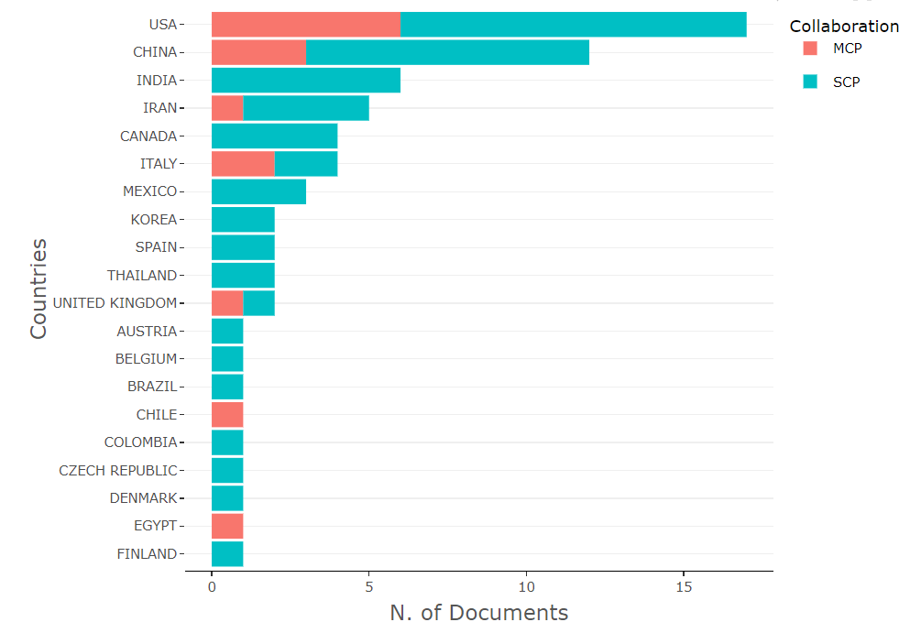
Corresponding Author's Country

Slide 7
Literature Review
Sl No | Author(s) (Year) | Article Type | Inference
1 | Braarud (2021) | Journal article (Research) | Awareness about NASA Total Load Index and Situational Awareness Rating Technique (SART) The understanding of TLX items involving analysis on the basic of operators have gained actual information.
2 | Harish et al., (2020) | Conference Proceedings | An experiment on manual sorting has been carried out with a linear sorting table, composed of three workstations and to be sorted items of different sizes and colors. It is identified that the sorting time varies with respect to the subject, number of items to be sorted, number of items left as residue, and the shape and size of the items.
3 | Iwona Zabinska (2020) | Journal article (Research) | In this paper Researcher analyze when doing sorting experiment on items in Industries then improving Technical and Psychological condition for Satisfactory work otherwise various types of accident done at work place due to excessive routine and incorrectly conducted training in companies.

Slide 8
Literature Review
Sl No | Author(s) (Year) | Article Type | Inference
4 | Berthelon et al., (2017) | Journal article (Research) | This study allowed to highlight model to explain performance to a complex task like driving. Task performance can be explained by matching of three categories of mental workload, i.e. intrinsic, extraneous and germane load
5 | Hart (2016) | Journal article (Review) | Applied NASA-TLX for the study.
6 | Hancock at al.,(2014) | Journal article (Review) | The essential characteristics of mental workload, examined the way it has evolved historically in the domain of ergonomics, and discussed current issues in study and application.

Slide 9
Literature Review
Sl No | Author(s) (Year) | Article Type | Inference
7 | Shwetha S (2012) | Journal article (Review) | In this paper the researcher essence of ergonomics has spread across many areas or applications to make work or task comfortable rather than easier doing in this way design of man machine system, consumer goods and service system, design of working environment.
8 | Atkins et al., (2012) | Journal article (Research) | Eye-tracking technology can be a valuable tool for assessing the mental workload of surgeons in the operating room.
9 | Lop at al.,(2011) | Journal article (Review) | In This Paper the study was focused on risk factors in the construction industry review, ergonomics mainly can be defined as the relationship between humans, machine systems, job design and the work environment. increase the likelihood of injury to musculoskeletal system. Working in uncomfortable static position or contact stress of muscles and tendon also will increase the likelihood of injury

Slide 10
Literature Review
Sl No | Author(s) (Year) | Article Type | Inference
10 | Heinz et al., (2008) | Journal article (Review) | Cognitive load was measured with subjective and objective assessment methods. High cognitive load users are generally unhappy with the relevant Online store and prefer to use the site search function than easy navigation.
11 | Rubio et al., (2004) | Journal article (Research) | The analysis of mental workload in a certain job leads to a number of practical implications for the training plans, the selection process, and task designing and redesigning. This research attempted to analyze and compare the characteristics of three measures of subjective mental workload: NASA-TLX, Subjective Workload Assessment Technique (SWAT), and Workload Profile (WP).

Slide 11
Research Gaps
Studies are needed to establish a causal link between the important parameters and sorting time.
In order to effectively evaluate mental workload, further study should be needed.

Slide 12
OBJECTIVES
Investigate the influence of the following sorting attributes on mental workload.
Number of items to be sorted
Available time for the task
Size of the items to be sorted
Color of the items to be sorted
Shape of the items to be sorted
Estimation of the performance measures (i.e., selection time and dropping time) in various scenarios.

Slide 13
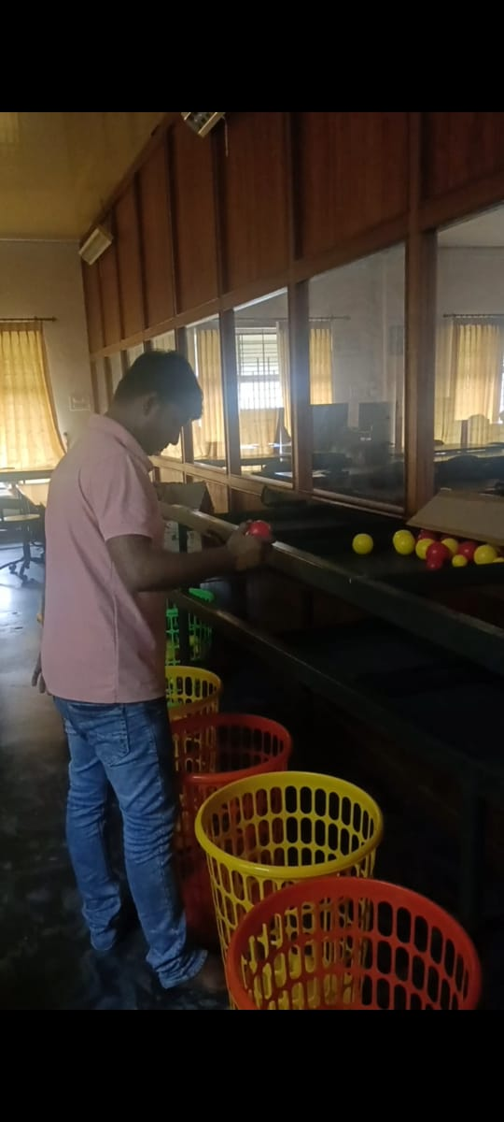
Experimental setup
In this experiment, sorting task conducted on a linear sorting table.
There are 3 pallates and different colour, shape and size of the items are mixed
4 bins are used for sorting the items to performed the task.

Slide 14
Methodology adopted
There are four scenarios in the proposed experimental design
Scenario 1: Random selection of items one at a time, without considering shape, size and colour.
Scenario 2: Selection of items on the basis of size.
Scenario 3: Selection of items on the basis of colour.
Scenario 4: Selection of items on the basis of both size and colour.
In each case, a subject will have fixed time-period to complete the experiment.
Video recording is conducted for the Work measurement.
Google form submitted by each and every subject (Worker) and gives rating on the basis of the sorting experiment conducted in IEM Lab.

Slide 15
Proposed Experimental Design
Attributes | Number of Levels | Description of Levels
Number of items to be sorted | 2 | 30, 40
Available time for the task | 2 | 40 sec, 50 sec
Size of the items to be sorted | 2 | Bigger, Small
Color of the items to be sorted | 2 | Red, Yellow
Shape of the items to be sorted | 2 | Spherical, Cubical

Slide 16
Table 1. Predictors and Levels
Factor | Type | Levels
Subject | Random | 21
Scenario | Random | 4
Attributes | Number of Levels | Description of Levels
Number of items to be sorted | 2 | 30, 40
Availble time for the task | 2 | 40 sec, 50 sec
Size of the items to be sorted | 2 | Bigger, Small
Color of the items to be sorted | 2 | Red, Yellow
Shape of the items to be sorted | 2 | Spherical, Cubical
16

Slide 17
Work done after mid-term evaluation
Increased the number of subjects from 12 to 21 for Sorting Experiment in Industrial Engineering Lab.
Attended and presented the work in the International Conference Humanizing Work and Work Environment (HWWE 2022) at Punjabi University Patiala which was held on 24-26 November 2022.
Conducted NASA-TLX questionaries survey among subjects.
Results analysis conducted-Developed Generalized Linear Model (GLM) using Minitab for the factors, Subjects and Scenarios with response variables errors made by the subjects and sorting time.

Slide 18
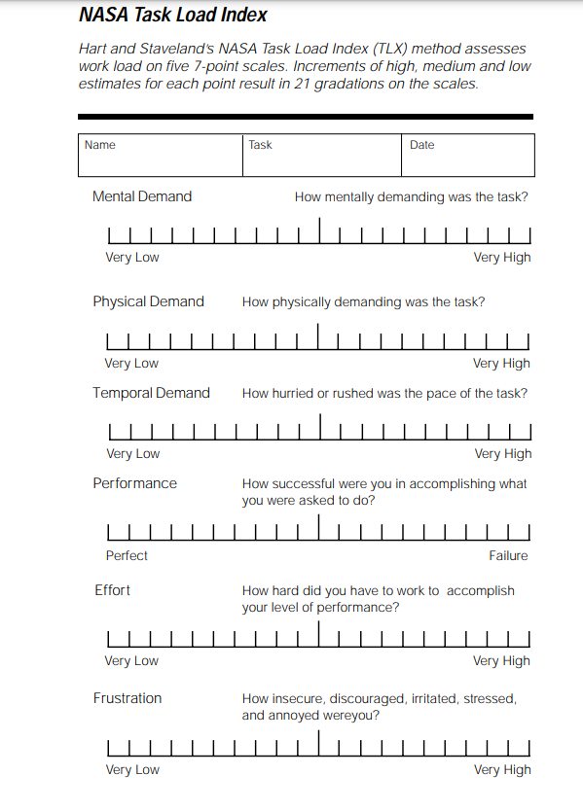
Screen-shot of NASA-TLX Questionnaire survey
The survey was conducted using Google form.
Here is the link of Google form survey.
https://docs.google.com/forms/d/e/1FAIpQLSfPTfghQxwxIQ_Kh3sYf1j2q1bkJlKZMsYZyYQAqz0wZn7zgg/viewform?usp=sf_link

Slide 19
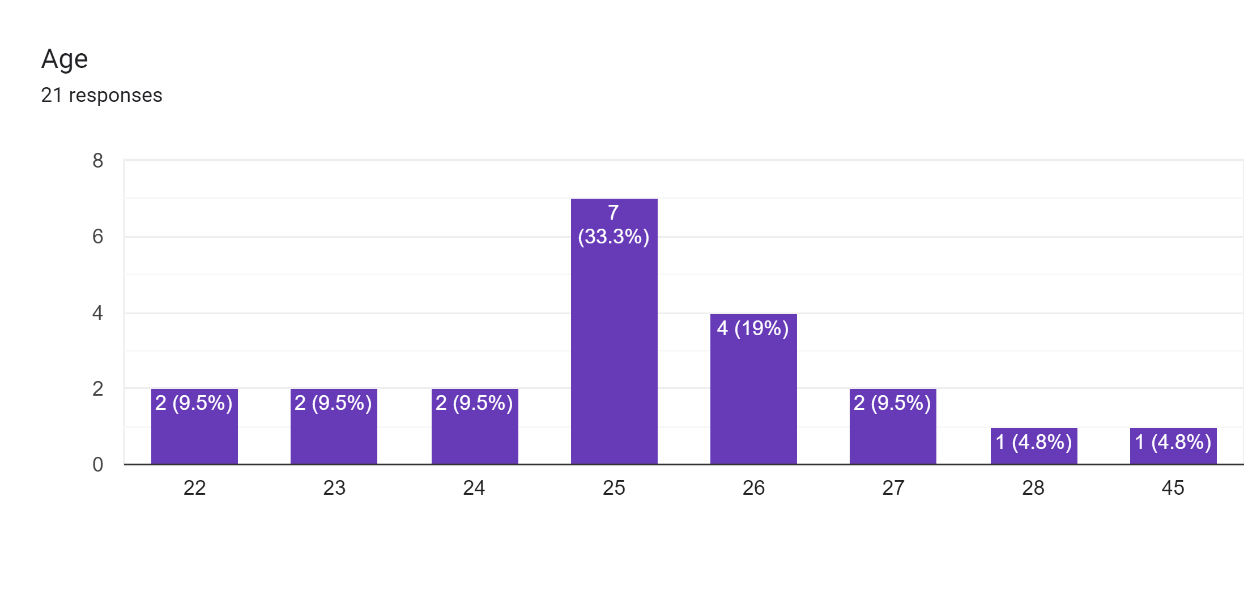
Responses received for NASA-TLX Questionnaire survey
No.of Subject
Age

Slide 20
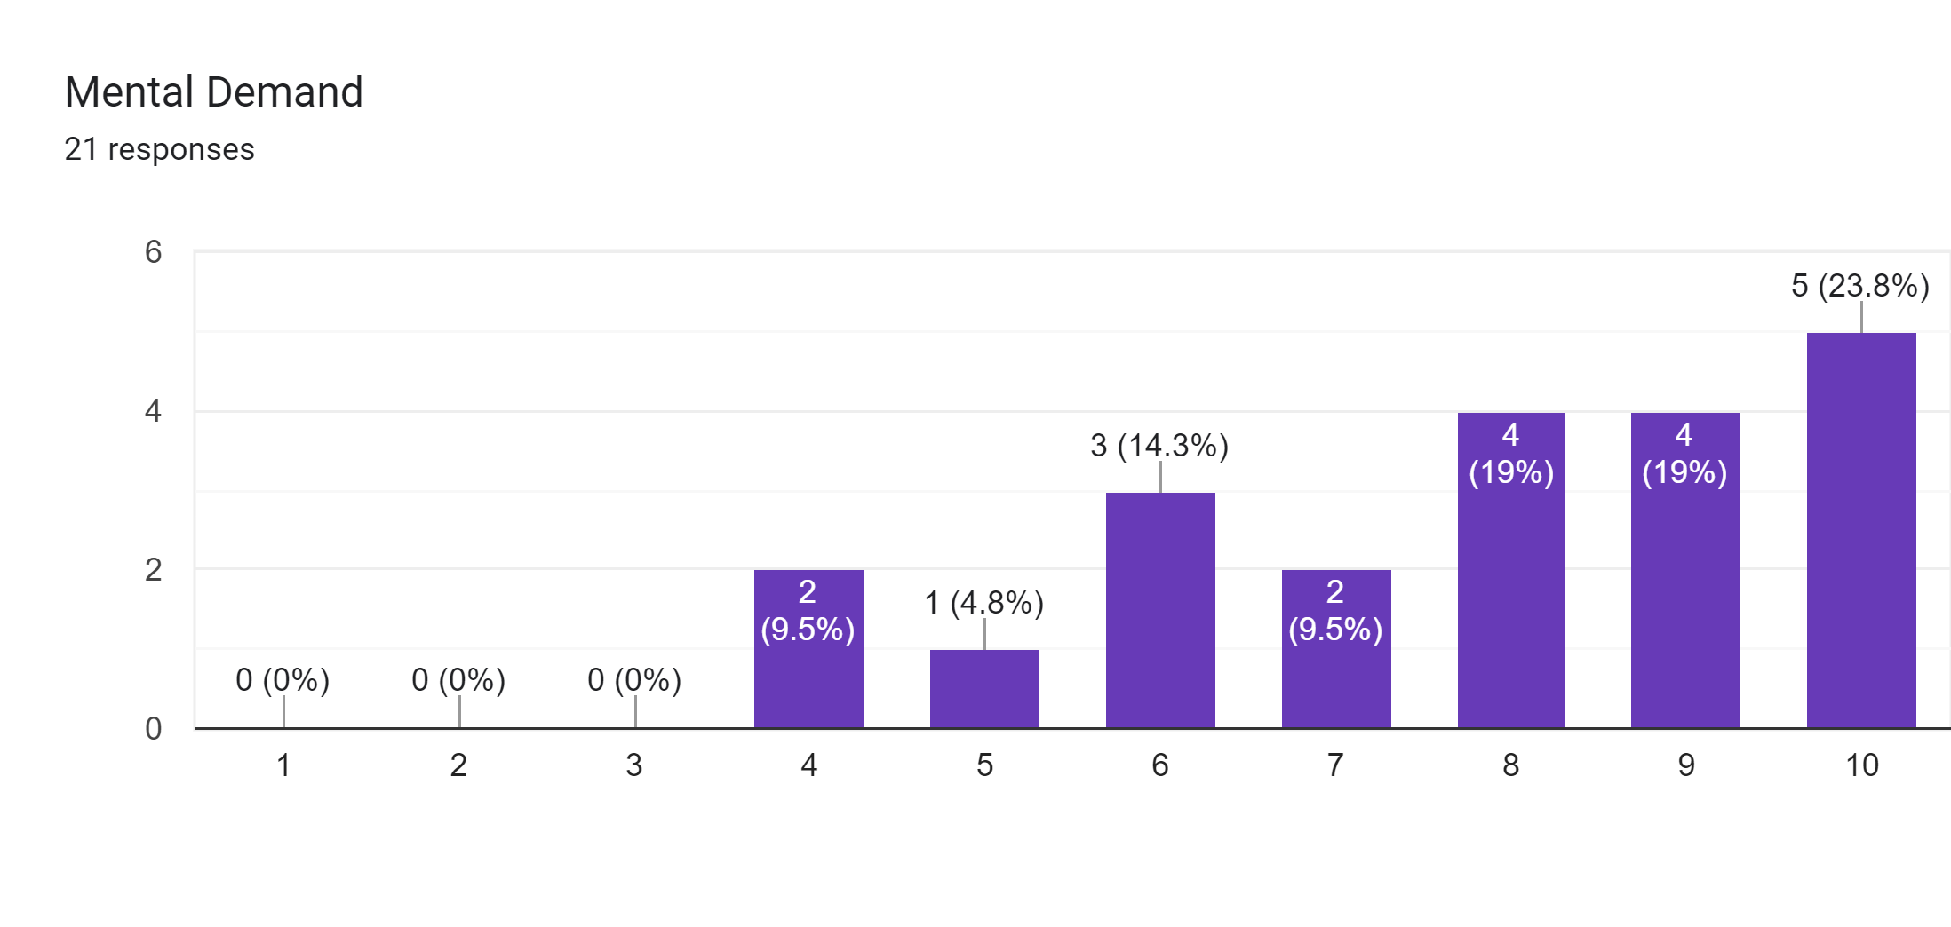
Responses received for NASA-TLX Questionnaire survey
kkmjhdjdjdjdjdjdjdj
No.of Subject
Range
20

Slide 21
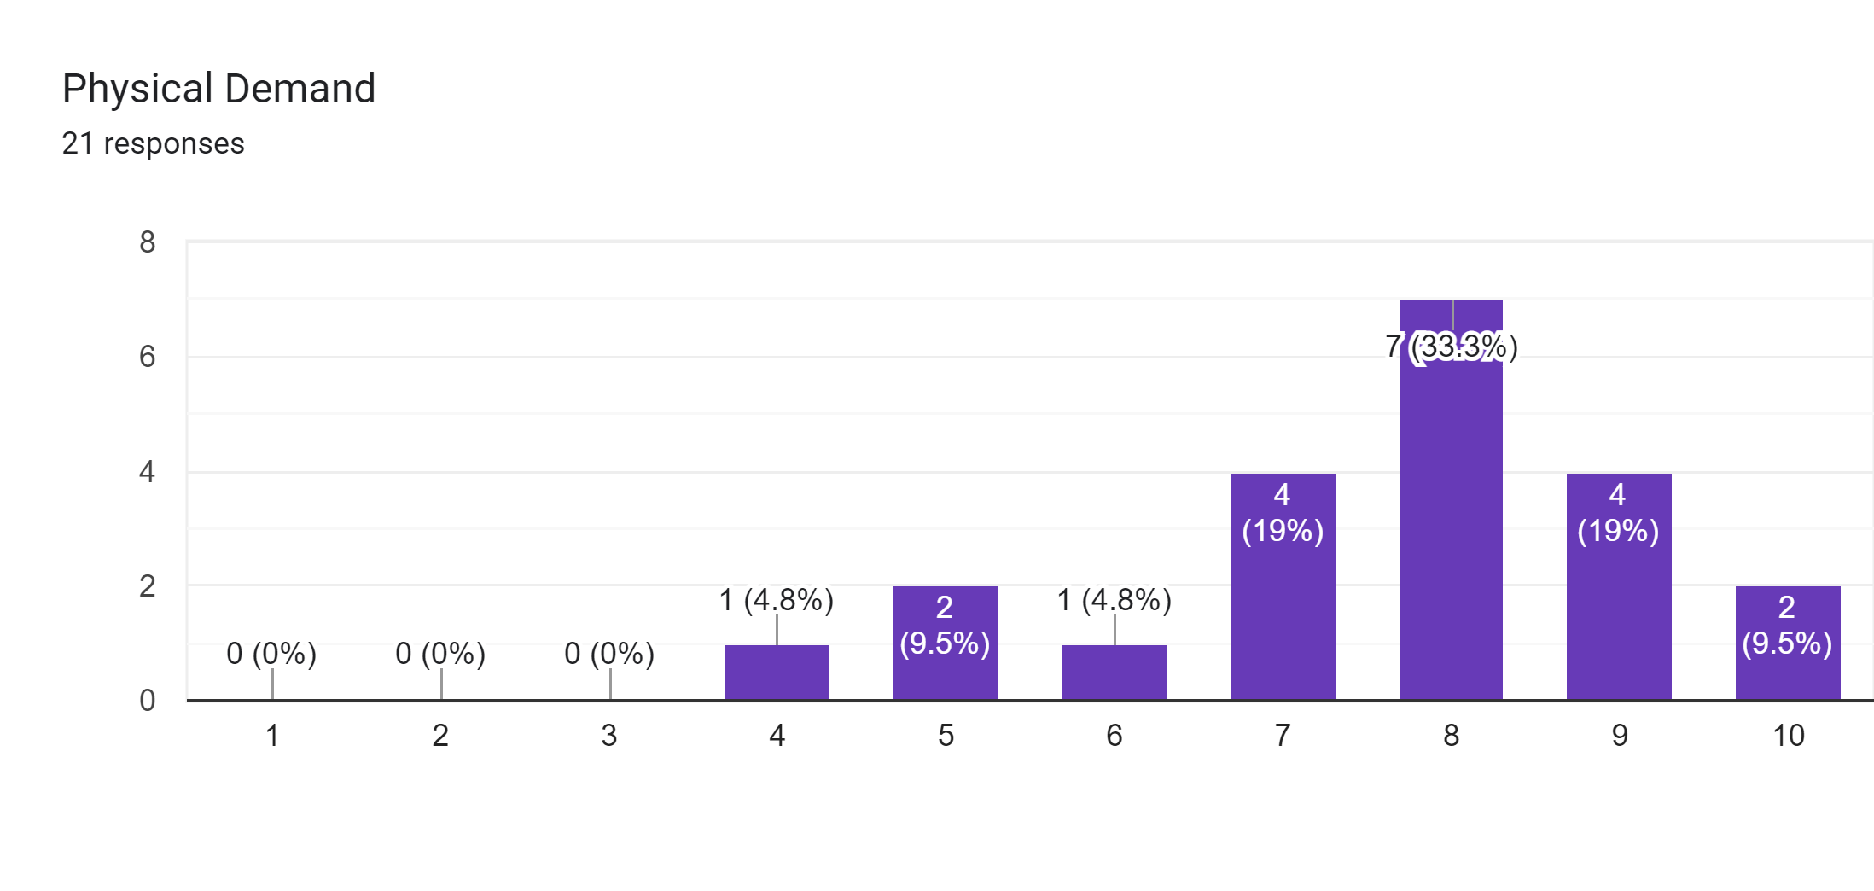
Responses received for NASA-TLX Questionnaire survey
No.of Subject
Range

Slide 22
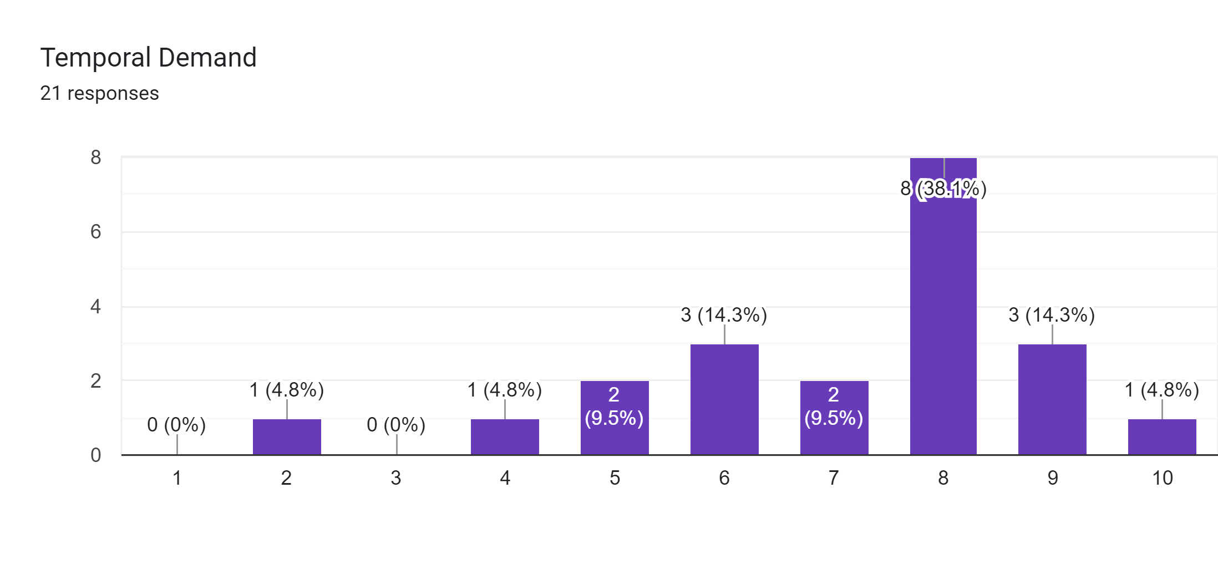
Responses received for NASA-TLX Questionnaire survey
No.of Subject
Range

Slide 23
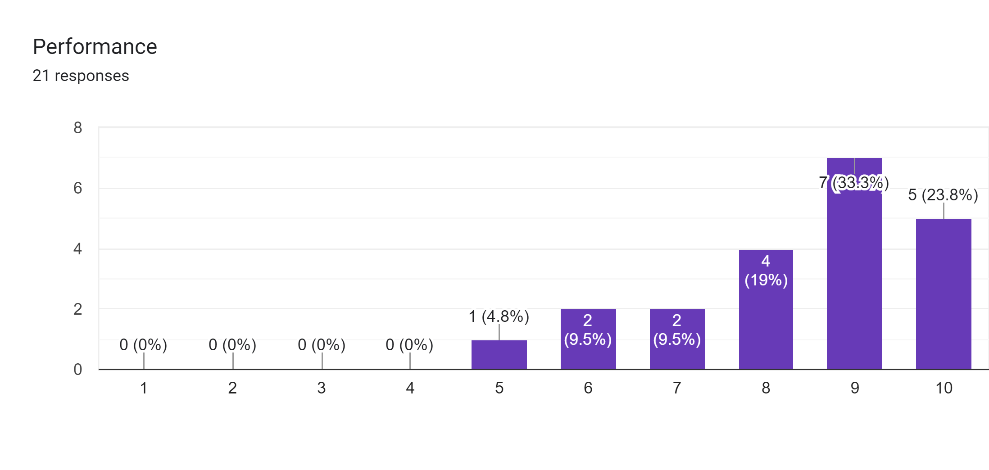
Responses received for NASA-TLX Questionnaire survey
No.of Subject
Range

Slide 24
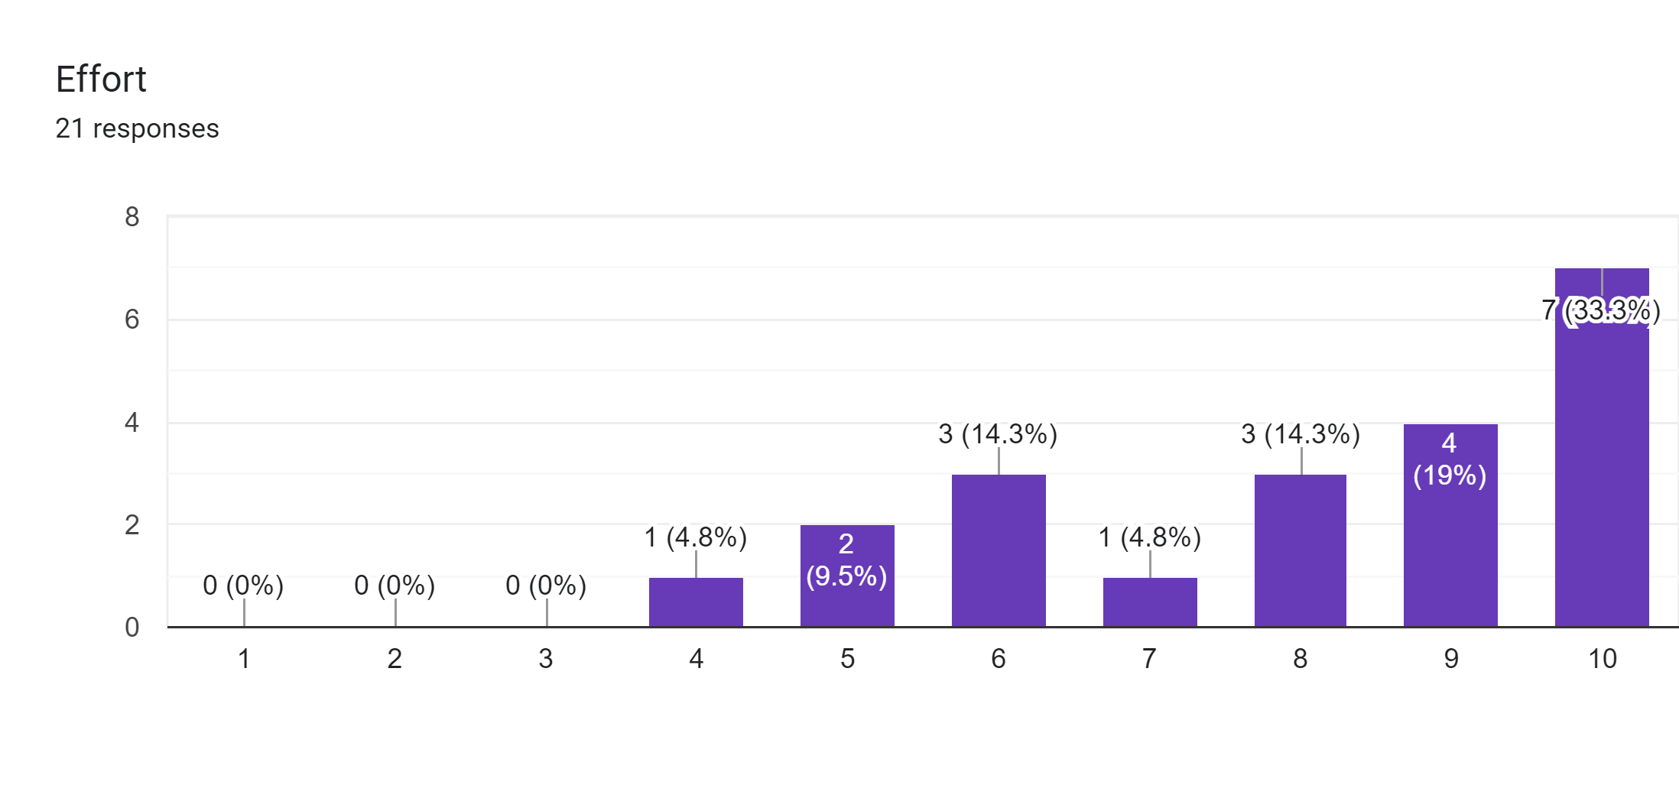
Responses received for NASA-TLX Questionnaire survey
No.of Subject
Range

Slide 25
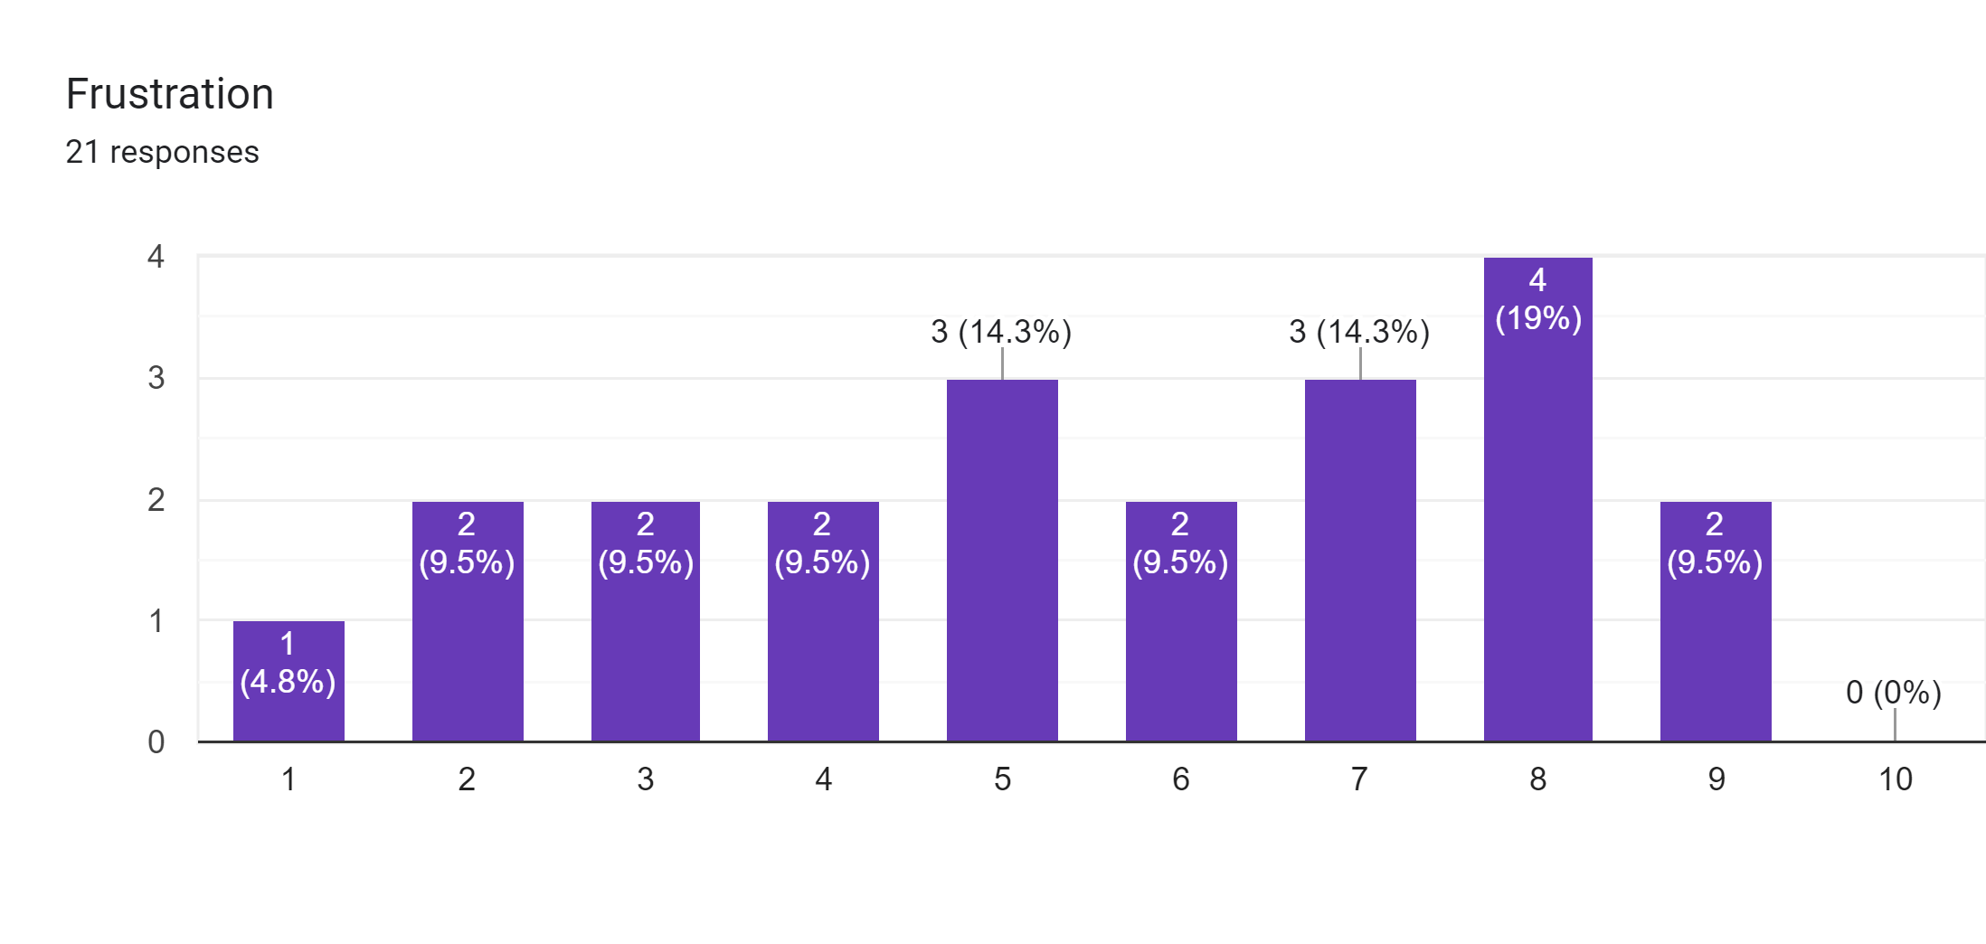
Responses received for NASA-TLX Questionnaire survey
No.of Subject
Range

Slide 26
Results
Compression of Mean
Scenario | Error | Sorting time
1 | 0 | 44.714
2 | 0.572 | 46.857
3 | 0.667 | 46.809
4 | 1.476 | 55.667

Slide 27
Results(cont’d)
Source | Degrees of freedom | Sum of Squares | Mean Sum of squares | F-Value | p-Value
Subject | 20 | 3935.2 | 196.76 | 18.01 | 0.000
Scenario | 3 | 1496.2 | 498.74 | 45.65 | 0.000
Error | 60 | 655.5 | 10.93
Total | 83 | 6087.0
Table 2. GLM Model output with Sorting time as response variable
Level of significance considered is 0.05

Slide 28
Results (cont’d)
Source | Degrees of freedom | Sum of Squares | Mean Sum of squares | F-Value | P-Value
Subject | 20 | 9.071 | 0.4536 | 2.27 | 0.008
Scenario | 3 | 23.274 | 7.7579 | 38.87 | 0.000
Error | 60 | 11.976 | 0.1996
Total | 83 | 44.321
Table 3. GLM Model output with number of errors as response variable
Level of significance considered is 0.05

Slide 29
Findings from the experimental study
It is observed that from the two different scenario’s of sorting tasks i.e., color and size the subjects are committing lesser mistake in scenario with different size compared to the scenario with different color.
It is observed that in scenario 4 minimum required time to completed the experiment is not sufficient because average time is more then given time to complete the experiment.
Manual sorting operations are repetitive, leading to worker’s underperformance due to mental fatigue.
This work investigates the influence of sorting attributes like size and colour on the mental workload.
The work revealed that there is a significant influence of sorting attributes on the performance of the subjects.

Slide 30
Project Timeline
 | Semester III |  |  |  |  | Semester IV
Work elements | Aug | Sep | Oct | Nov | Dec | Jan | Feb | Mar | Apr | May
1. Literature review
2. Problem identification
3. Experimental design
4. Conduct of experiments
5. Data processing
6. Result analysis and additional experiments
7. Documentation and publication

Slide 31
Publication from the work
A study titled “Influence of sorting attributes on mental workload” has been presented in the International conference on Humanizing Work and Work Environment (HWWE 2022) Organized by Punjabi University Patiala during 24-26 November 2022.

Slide 32
References
Galy E, Paxion J, Berthelon C. Measuring mental workload with the NASA-TLX needs to examine each dimension rather than relying on the global score: an example with driving. Ergonomics. 2018 Apr;61(4):517-527. doi: 10.1080/00140139.2017.1369583. Epub 2017 Sep 8. PMID: 28817353.
Hart, S. G. (2006). Nasa-Task Load Index (NASA-TLX); 20 Years Later. Proceedings of the Human Factors and Ergonomics Society Annual Meeting, 50(9), 904 908
.https://doi.org/10.1177/154193120605000909.
Sandra G. Hart, Lowell E. Staveland,Development of NASA-TLX (Task Load Index): Results of Empirical and Theoretical Research,Editor(s): Peter A. Hancock, Najmedin Meshkati,Advances in Psychology,North-Holland,Volume 52,1988,Pages 139-183,ISSN 0166-4115,ISBN 9780444703880, https://doi.org/10.1016/S0166-4115(08)62386-9.
Zheng B, Jiang X, Tien G, Meneghetti A, Panton ON, Atkins MS. Workload assessment of surgeons: correlation between NASA TLX and blinks. Surg Endosc.2012 Oct;26(10):2746-50. doi: 10.1007/s00464-012-2268-6. Epub 2012 Apr 24. PMID: 22527300.

Slide 33
Sai Rama Krishna Harish, N., Vamshi, M., Bhanu Prakash, K., Ezra, P., Emmatty, F.J., Panicker, V.V. (2021). Identification of Factors Influencing Mental Workload in Manual Sorting. In: Pant, P., Mishra, S.K., Mishra, P.C. (eds) Advances in Mechanical Processing and Design. Lecture Notes in Mechanical Engineering. Springer, Singapore. https://doi.org/10.1007/978-981-15-7779-6_63.
N. Jaffar, A.H. Abdul-Tharim, I.F. Mohd-Kamar, N.S. Lop,A Literature Review of Ergonomics Risk Factors in Construction Industry,Procedia Engineering,Volume 20,2011,Pages 89-97,ISSN 1877-7058.
S, Shwetha. (2021). Applications of Ergonomic Studies in India: A Literature Review. IOP Conference Series: Materials Science and Engineering. 1033. 012025. 10.1088/1757-899X/1033/1/012025
Żabińska, Iwona. (2020). AWARENESS OF ERGONOMIC WORKING CONDITIONS AMONG EMPLOYEES. Scientific Papers of Silesian University of Technology. Organization and Management Series. 2020. 181-194. 10.29119/1641-3466.2020.142.13.

Slide 34
Thank You

